Slide 1
Crime Terms
Matching Activity

Slide 2

Embezzlement
Taking property you have been entrusted with

Slide 3
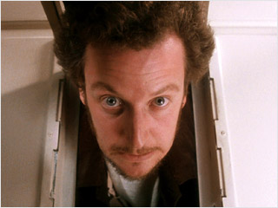
Burglary
Unlawlful entry into a building with the intent to commit a crime, usually theft

Slide 4
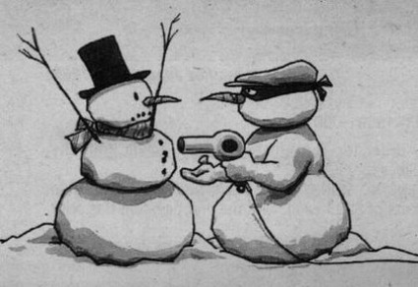
Extortion
Making a threat with the intent of getting property (usually money) from another person

Slide 5
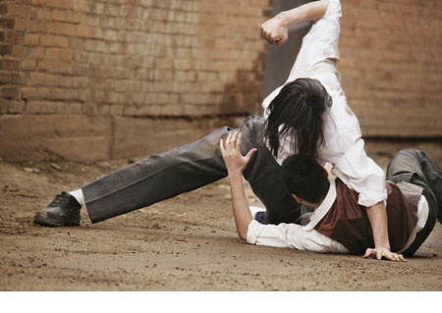
Aggravated Assault
Weapons used OR person needs medical attention
* May be chargeable as attempted murder

Slide 6
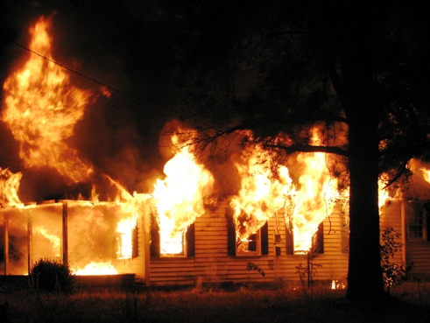
Arson
The burning OR attempted burning of property with or without the intent to defraud

Slide 7
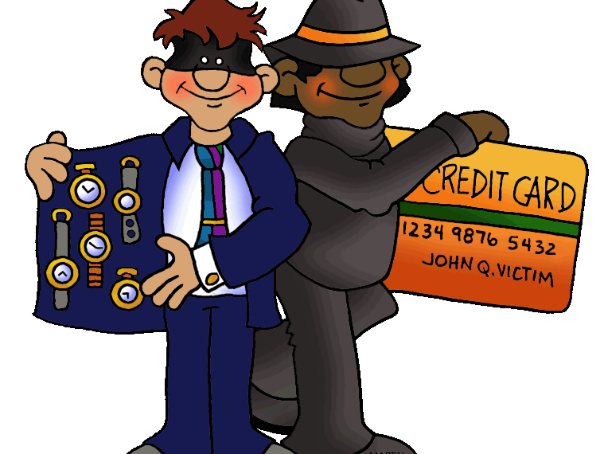
Fraud
Knowingly misrepresenting a fact to get property from another person

Slide 8
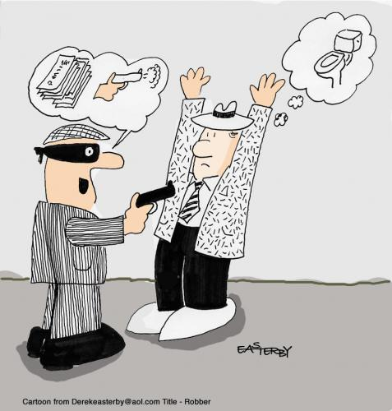
Robbery
A crime against a person. Forcible stealing property by violence or the threat of violence

Slide 9

Larceny
Theft; taking without permission someone’s property and not intending to give it back

Slide 10
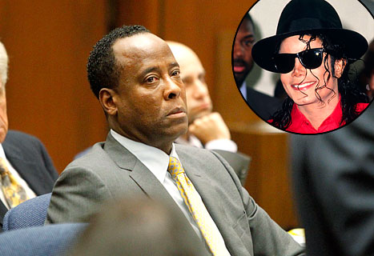
Involuntary Manslaughter
Unintended killing that takes place during a crime or by criminal negligence

Slide 11

Simple Assault
The unlawful intentional inflicting, or attempting, or threatened inflicting, of injury upon the person of another (without a weapon)

Slide 12

1st Degree Homicide
Premeditated (or planned out) murder of another human being

Slide 13

2nd Degree Homicide
Murder of another human being, done in the “Heat of the Moment” with malice

Slide 14

Sexual Assault
A wide range of victimizations, separate from rape or attempted rape. These crimes include attacks or attempted attacks generally involving unwanted sexual contact between victim and offender. Sexual assaults may or may not involve force and include such things as grabbing or fondling. Sexual assault also includes verbal threats.

Slide 15

Identity Theft
Includes one or more of three types of incidents: (1) unauthorized use or attempted use of an existing account, (2) unauthorized use or attempted use of personal information to open a new account, (3) misuse of personal information for a fraudulent purpose.

Slide 16
Battery
the use of force against another, resulting in harmful, offensive or sexual contact

