Slide 1
Your Own Advocacy Leadership Institute In a Box

Slide 2
Brock Howell
brockh@cascade.org, 206-856-4788 Policy & Government Affairs Manager, Cascade Bicycle Club

Slide 3
Agenda
Purpose & History
Overview
Workshop Breakouts

Slide 4
Credits
Max Hepp-Buchanan, Bike Walk RVA
Craig Benjamin, Jackson Hole Conservation Alliance
Many, many prior organizations and organizers

Slide 5
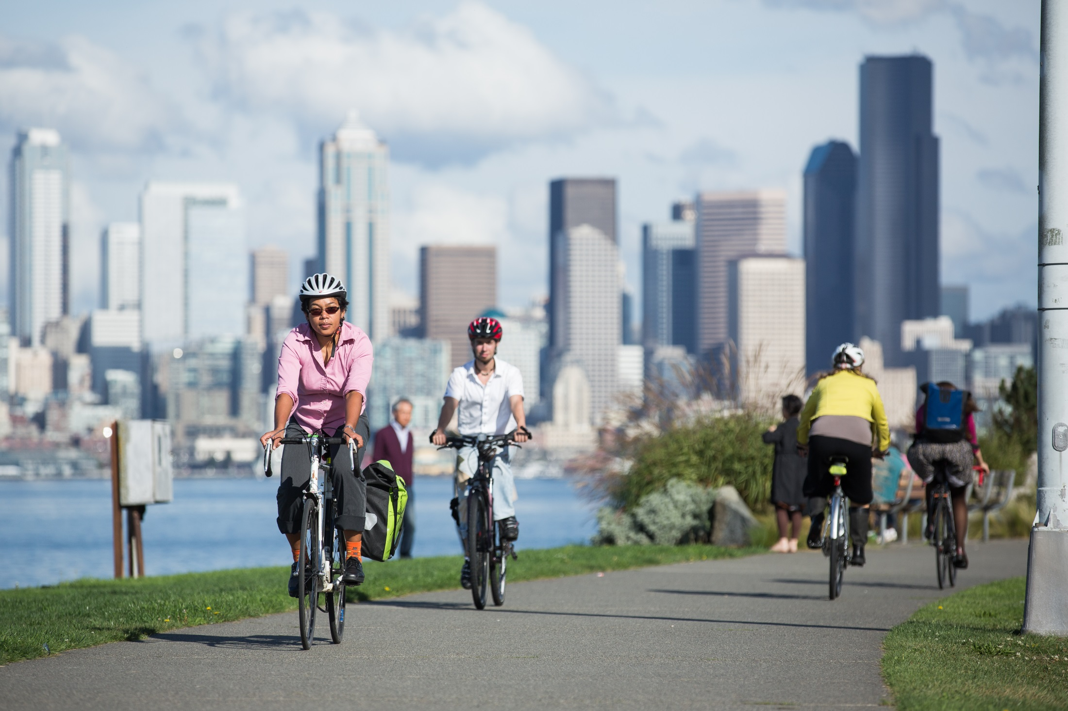

Slide 6
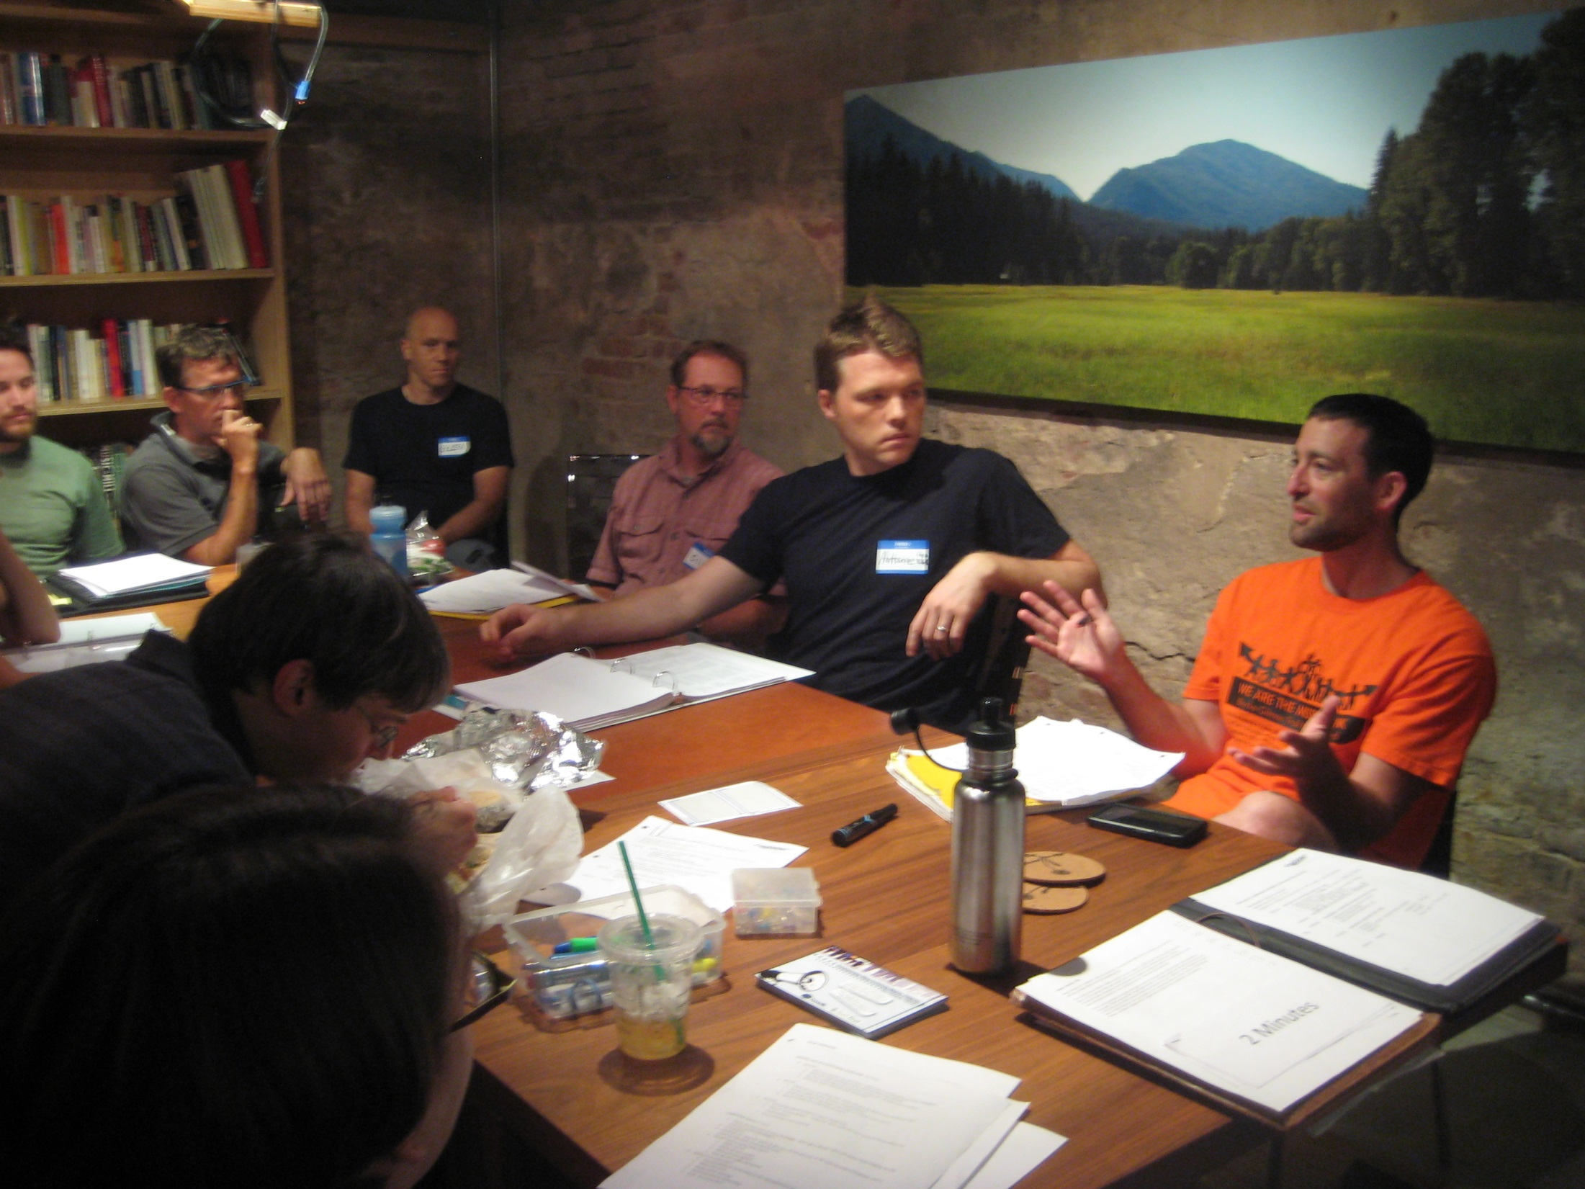

Slide 7
Purpose & History
5 minutes

Slide 8
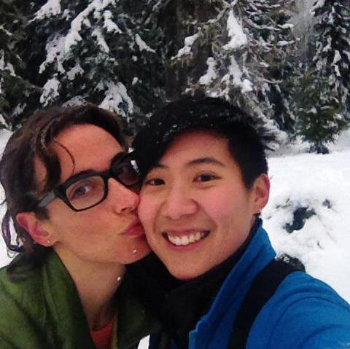

Slide 9
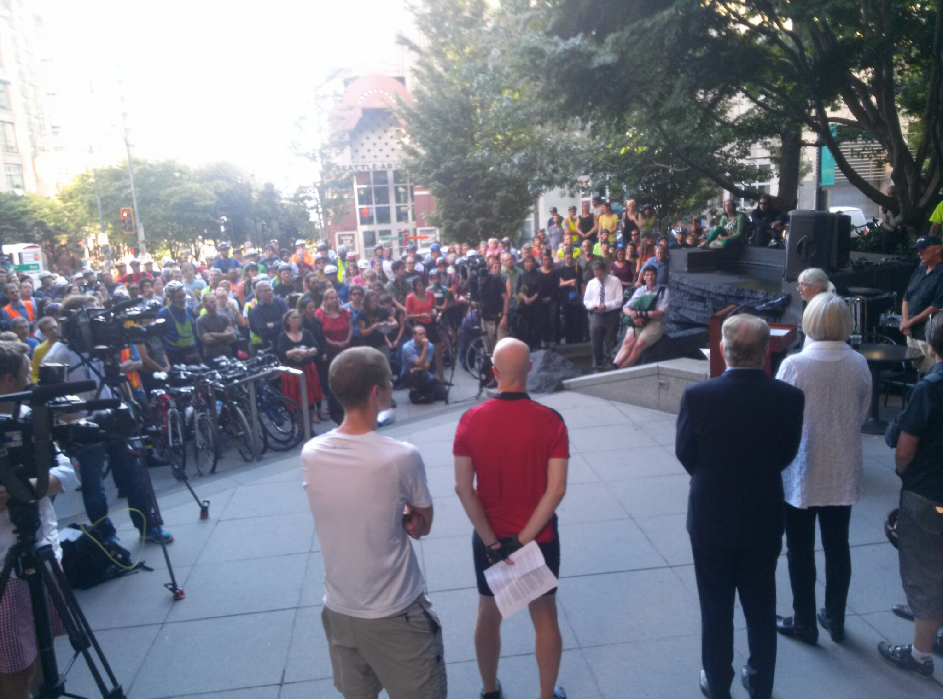

Slide 10
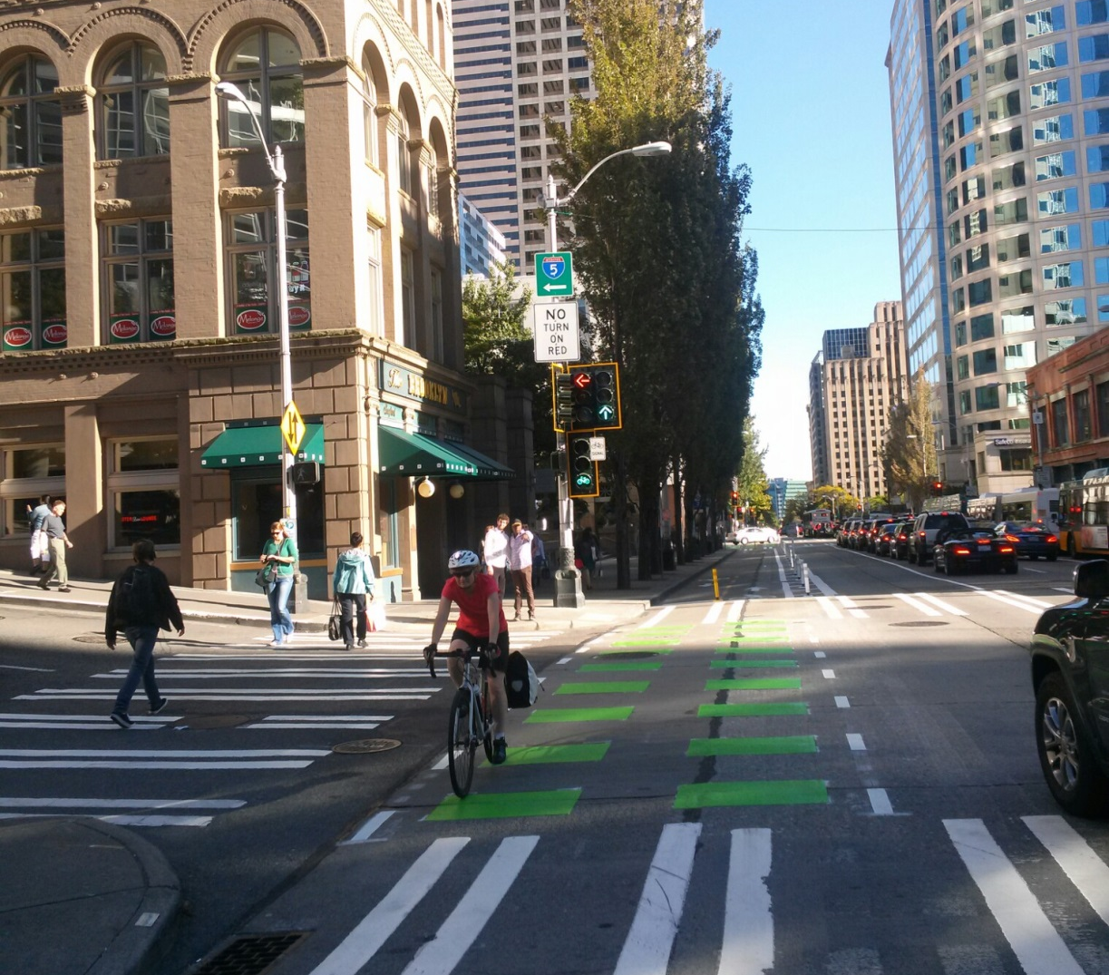

Slide 11
Purpose & History
2011
After 3-year organizing effort, we lose big on a ballot measure.

Slide 12
Purpose & History
2012
Set new goals for building new bikeways
Scope & start an advocacy training program
Messaging Work
Participate in Progressive Narrative Training
Work with Pollster & Messaging Consultant to create a Pro-Bike Narrative
Lay the foundation for a grassroots organizing structure to be called “Connect Seattle”

Slide 13
Purpose & History
People will show up if they believe in what you are doing. But you need to:
Develop and empower leaders:
Meet them where they’re at.
Maximize their existing skills and teach them new ones.
Provide them with resources
Provide them with a structure within which they can be successful.
Foster a sense of comradery.
Celebrate success.

Slide 14
Purpose & Need
Build a citywide network of effective advocates for bikeways & street safety who can:
Plan and execute a campaign
Organize in their communities
Communicate strategically
Navigate city departments
Celebrate a victory

Slide 15
Purpose & History
We’ve now held five series of our 8-week ALI program, and two “Boot Camps.”
Bike Walk RVA and Jackson Hole Conservation Alliance have held their own new “ALIs”

Slide 16
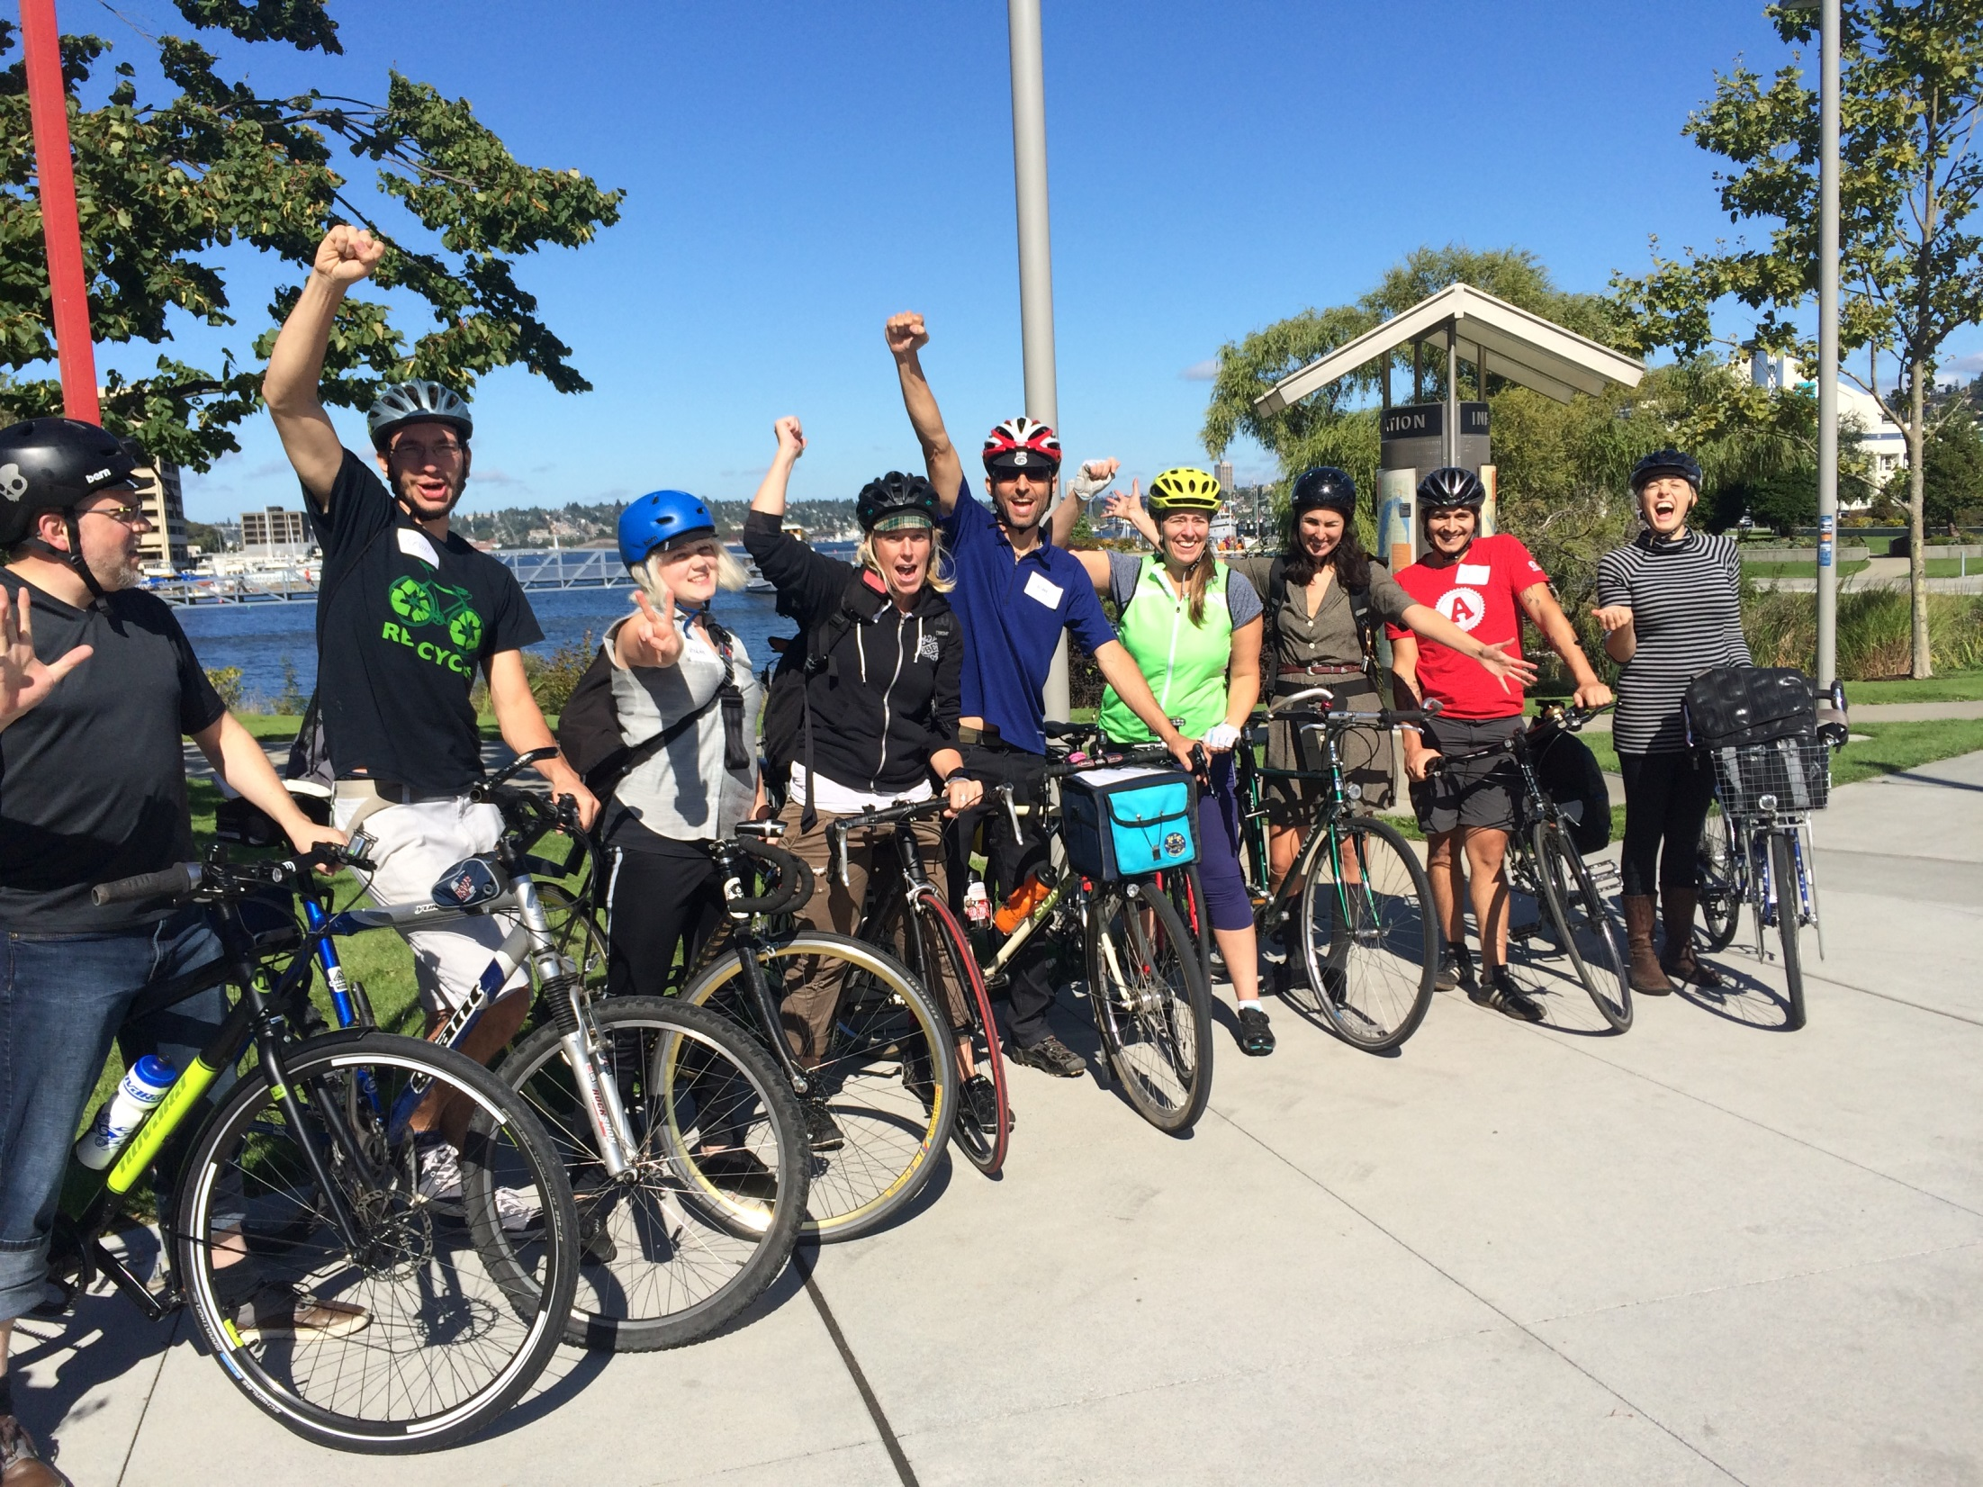
Number of People Trained
~90 people through our full 8-week program,
~45 through our Bootcamps

Slide 17
Purpose & History
They’ve gone onto:
Lead our Connect Seattle neighborhood teams.
Start local neighborhood street safety groups.
Other:
Urban design professionals
Bike Share General Manager
Bike Shop Owner
Bike-Ped Coordinator for regional transit agency
Cascade’s Staff & Board of Directors

Slide 18
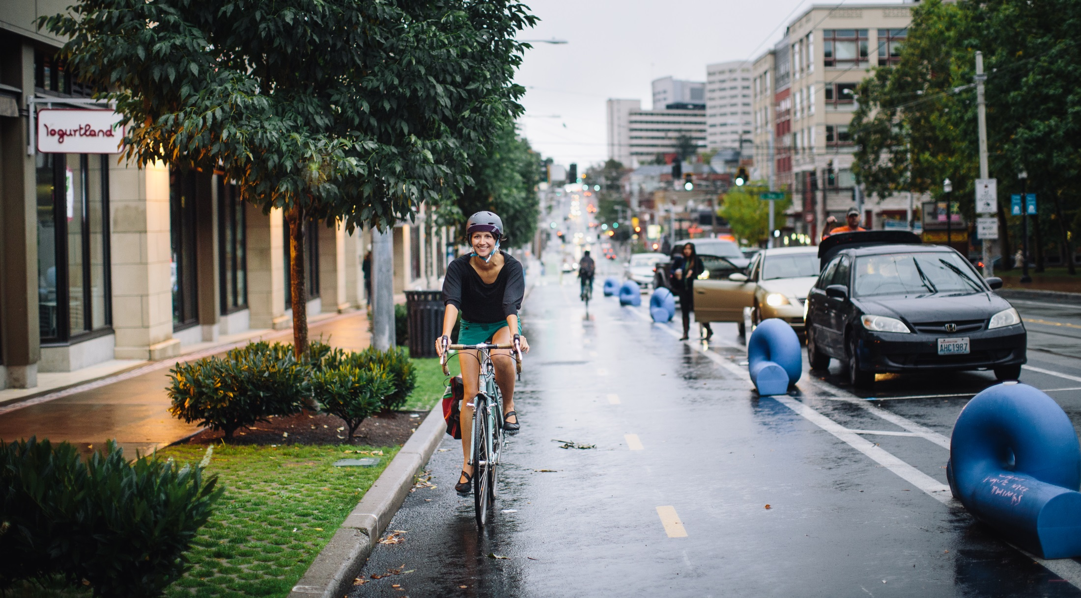

Slide 19
Outline
15 minutes

Slide 20
Outline
Eight-Week Program
Retreat
Weeks 1-8
Graduation
Bootcamp
Pack it all into 1-3 days
Possibly get commitments to organize on campaigns for following 8 weeks.

Slide 21
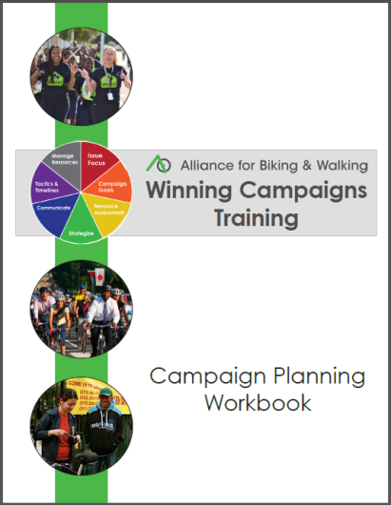
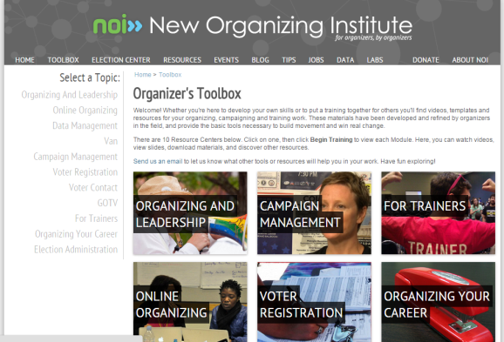
Outline

Slide 22
Core Organizing Principles
Narrative
Strategic Campaigns
Build a Network of Teams

Slide 23
PFCJQNAI

Slide 24
Narrative
Story of Self
Story of Us (the organization)
Story of Now (the campaign)

Slide 25
Strategic Campaigns
Goal
Target
Theory to Win
Tactics
Timing

Slide 26
Recruit
Develop
Mobilize
Celebrate

Slide 28
Outline
Retreat
8 weeks of classes + team campaign work
Graduation

Slide 29
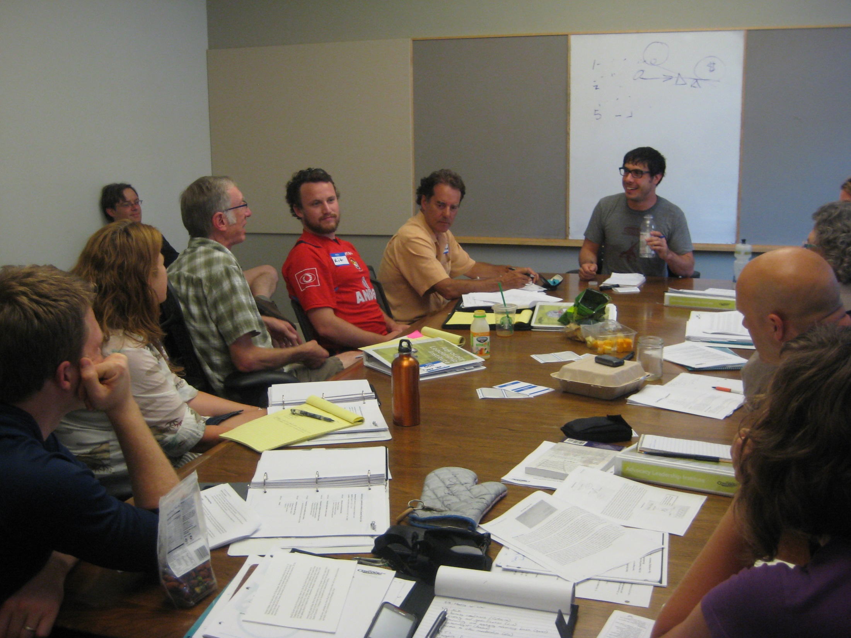

Slide 30
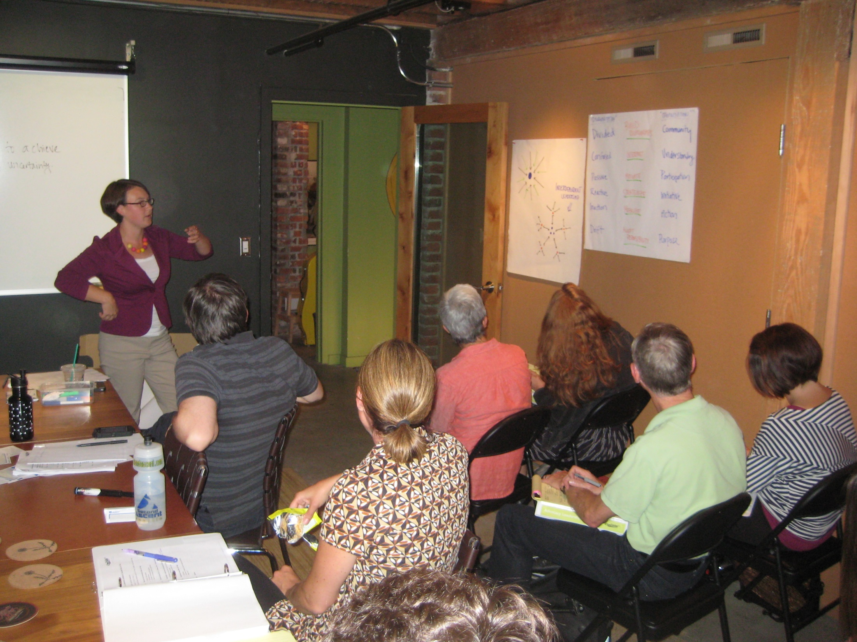

Slide 31
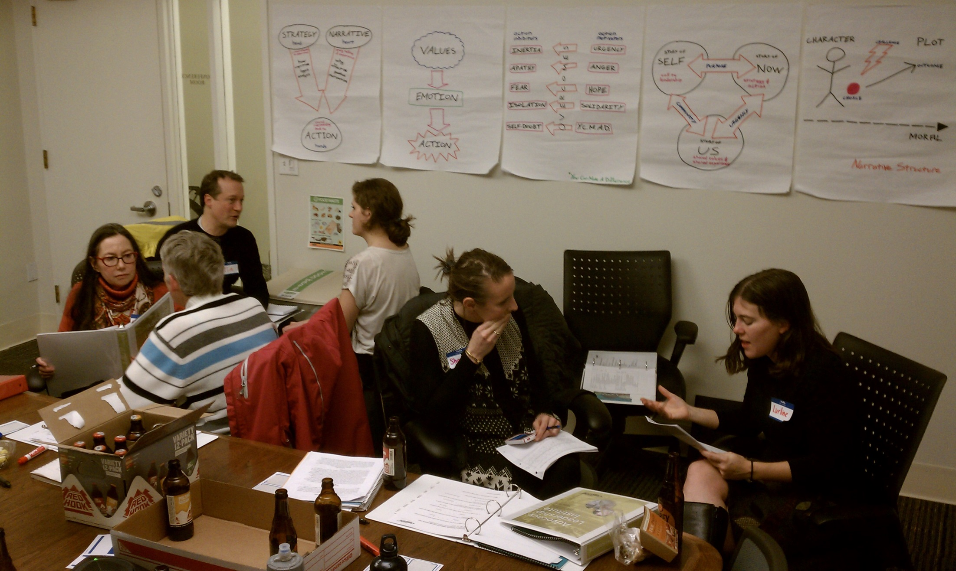

Slide 33
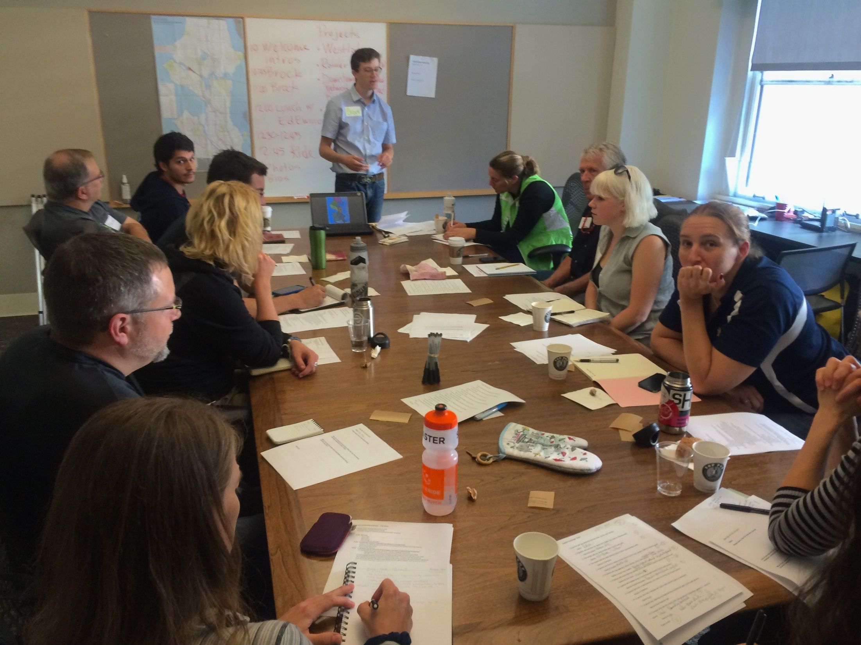

Slide 34
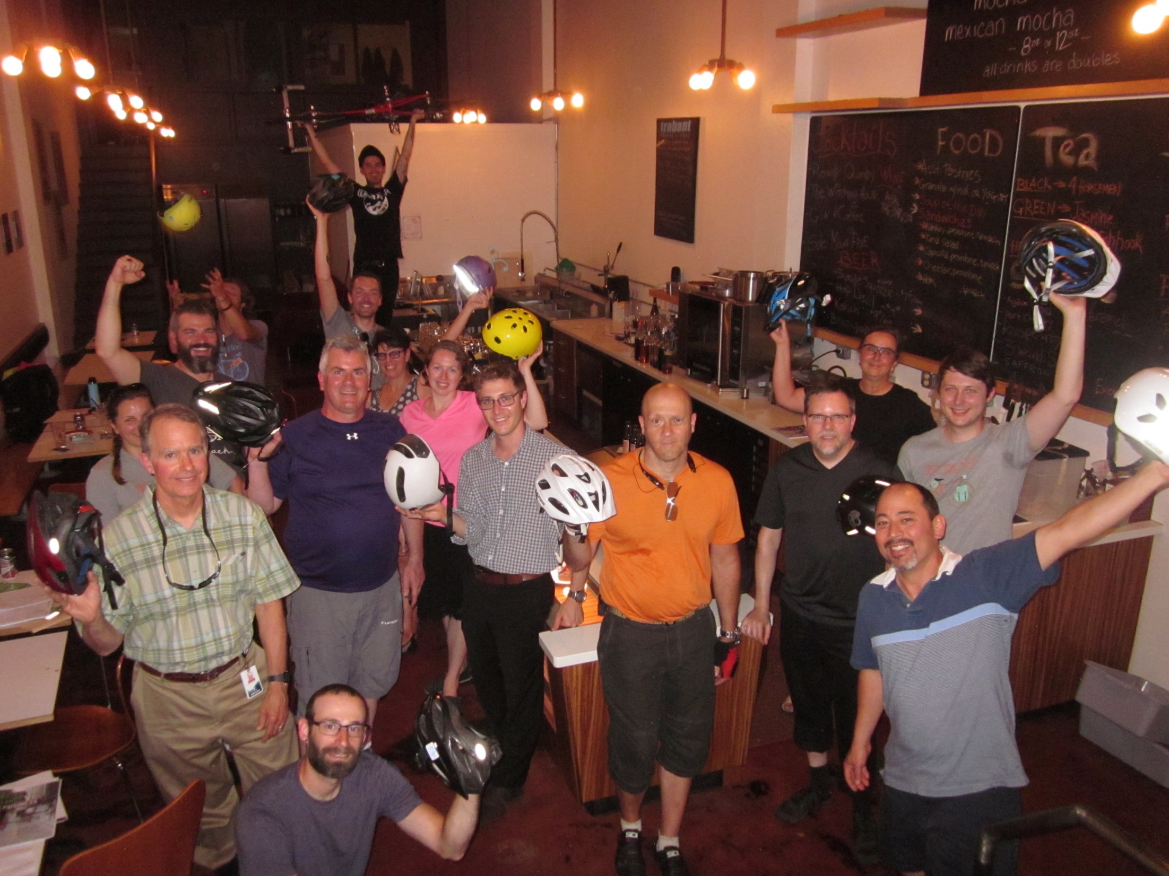

Slide 35
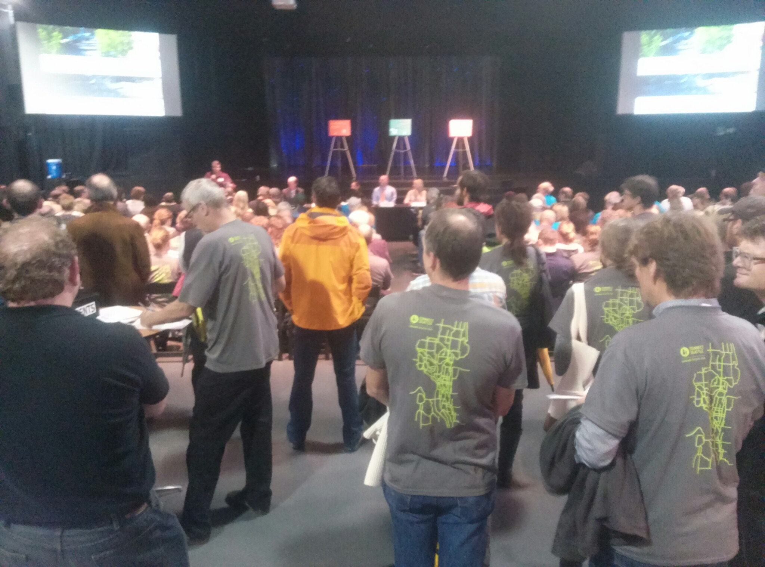

Slide 36
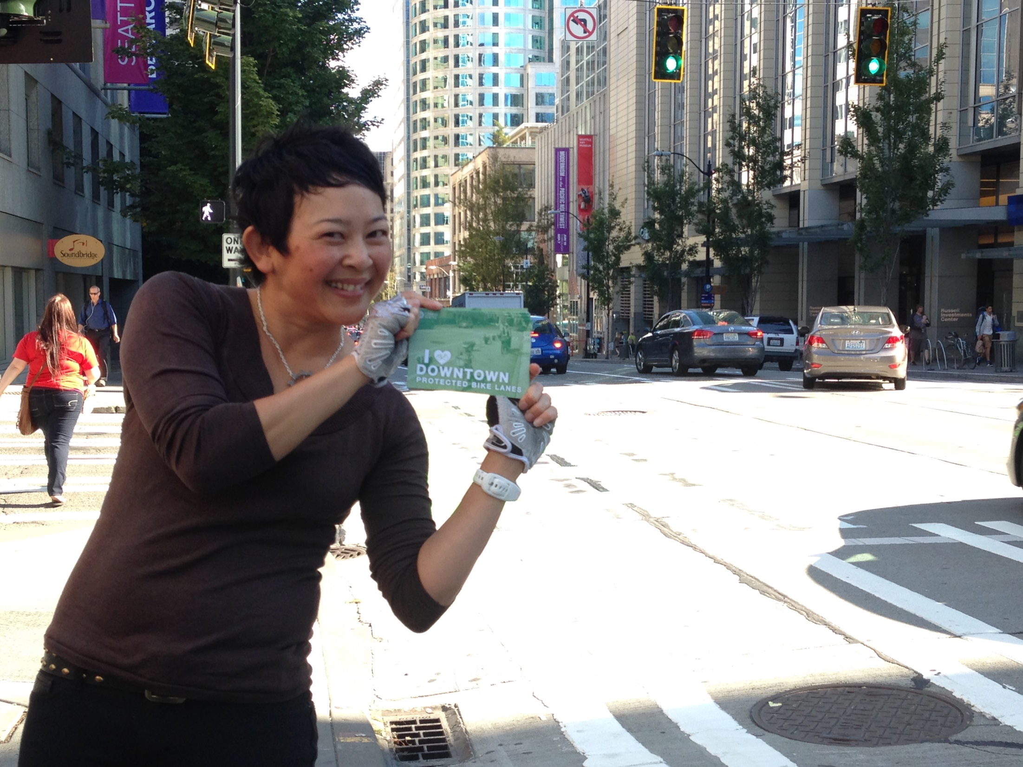

Slide 37
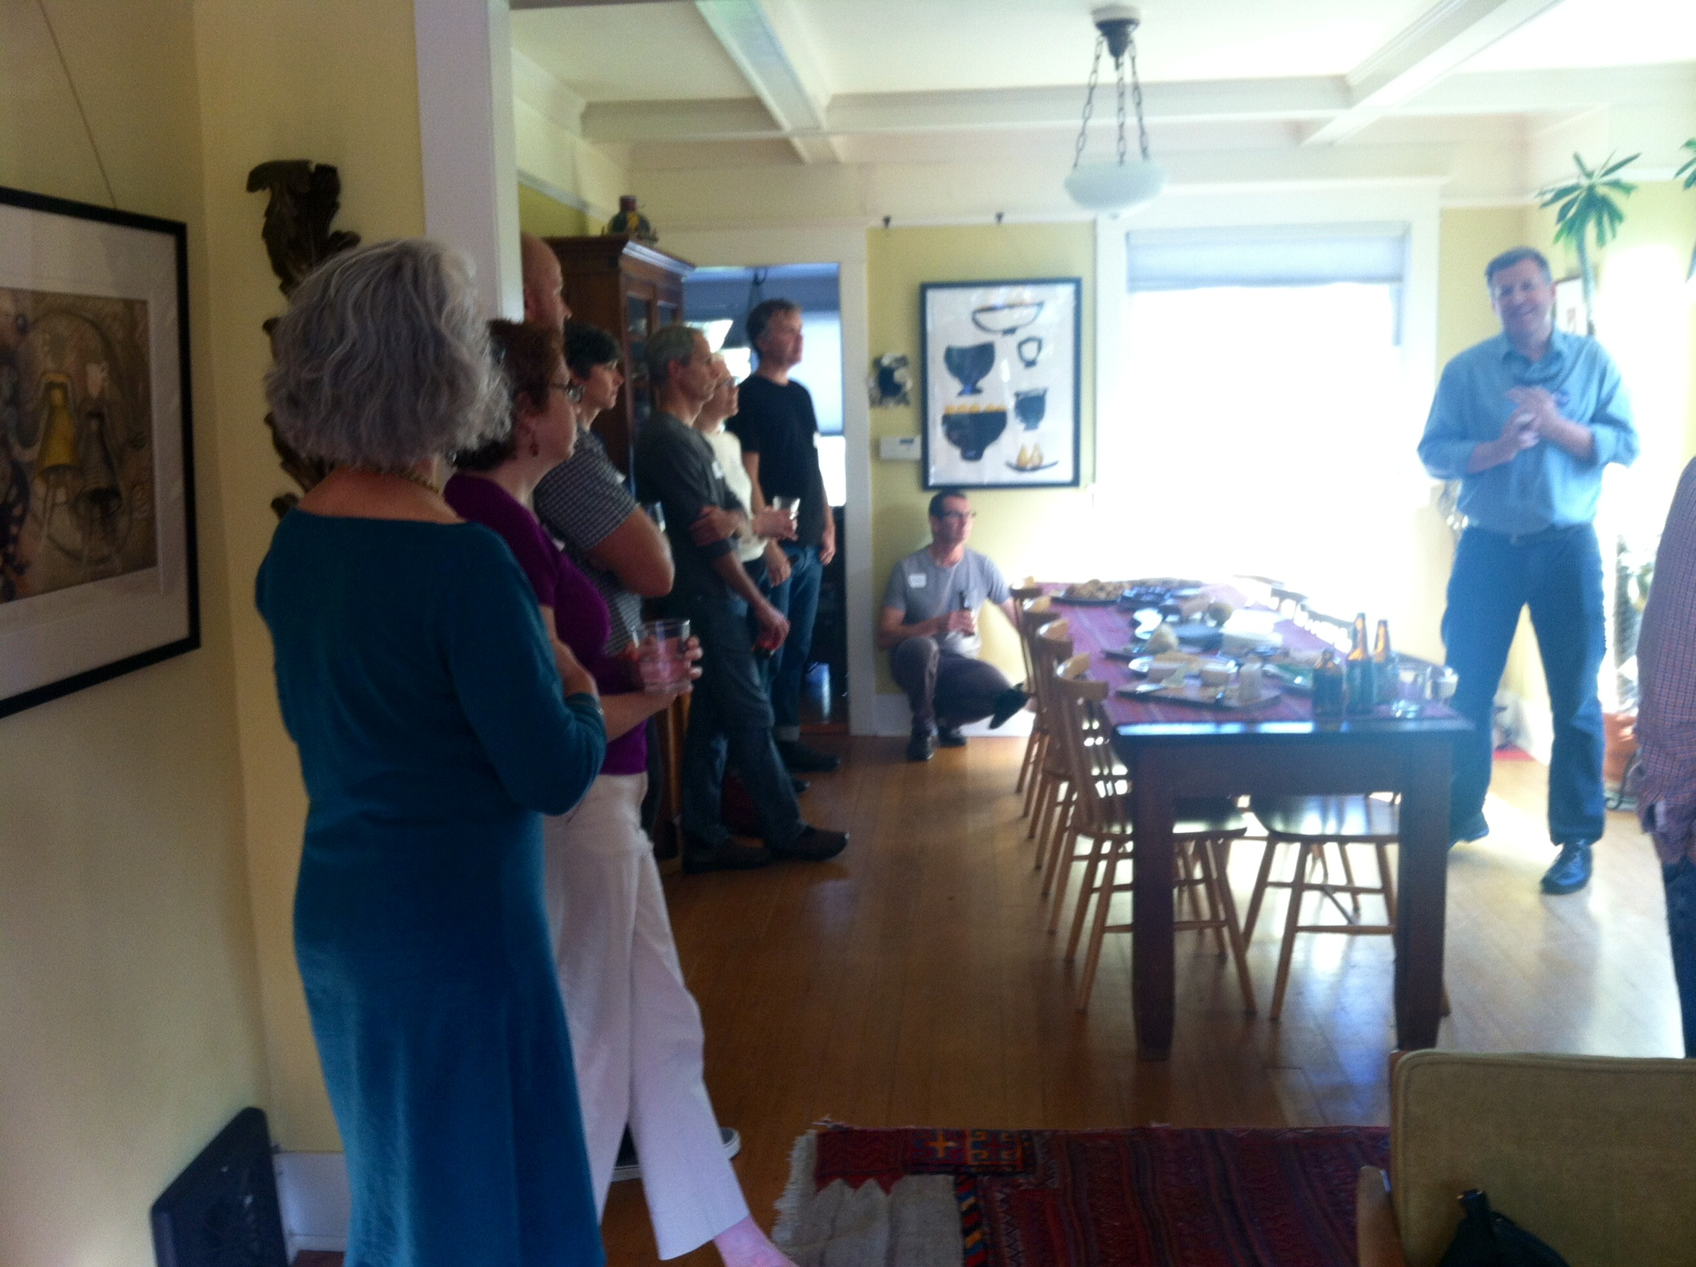

Slide 38
Outline
Retreat:
Story of Self
Common Language
Setting Values & Expectations
Group Bonding

Slide 39
Outline
8 weeks of 2-3 hour classes on specific topics
Reading requirements/suggestions
Guest Speakers
Training/Discussion on Topic
Team campaigning
Story of self exercises

Slide 40
Outline
Transportation Policy Civics & Issue Selection
Campaign Planning
Targeting & Powermapping
Tactics
Messaging & Media
Volunteer Recruitment & Leadership Development
Coalition Building
Moving Forward
Bike Infrastructure 101
Framing & Messaging
Media Work
Event Organizing
Lobbying
Individual Tactics
Electioneering
Electoral Campaign Planning
Phonebanking & Canvassing
GOTV

Slide 41
Outline
Each Class:
5 min - Welcome
20 min - Personal Story Telling
30 min - Guest Speaker
30 min - Training
30 min - Team Work
5 min - Wrap-up

Slide 42
Outline
Graduation
Dinner at a VIP’s house
Shirts
Graduation Certificates
Include past alumni

Slide 43
Outline
Guest Speakers
City Councilmembers
State elected officials
Fellow grassroots activists and organizers
Big-time campaign managers
Famous local media personalities
City bike/ped planners
Organization Executive Directors

Slide 44
Outline
Recruitment:
Moms & • Dads
Retirees
Teachers
Librarians
Civic association leaders
Family-biking enthusiasts
Reflects your community:
Geographic
Gender
Race & Ethnicity
Age
or target a demographic

Slide 45
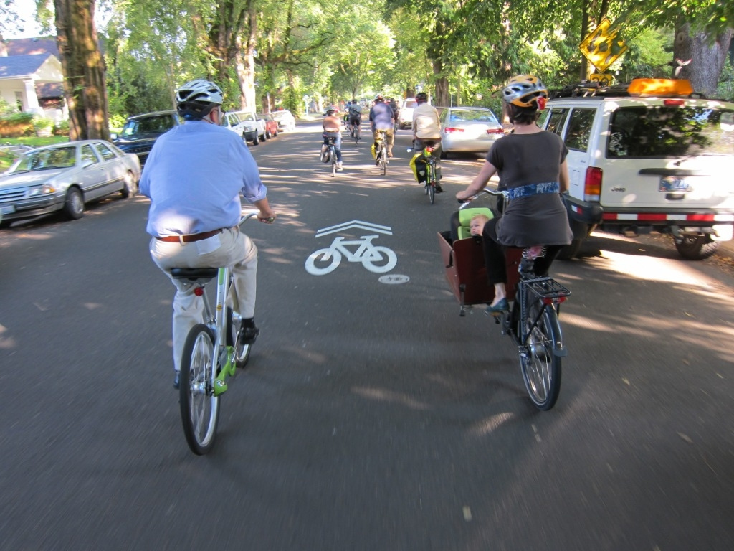

Slide 46
Workshop Breakouts
10 minutes each

Slide 47
Workshop Breakouts
Set a schedule
Find your people
Plan a retreat
Importance of Storytelling
Build a guest speaker list
Class structure
Celebration & continued engagement

Slide 48
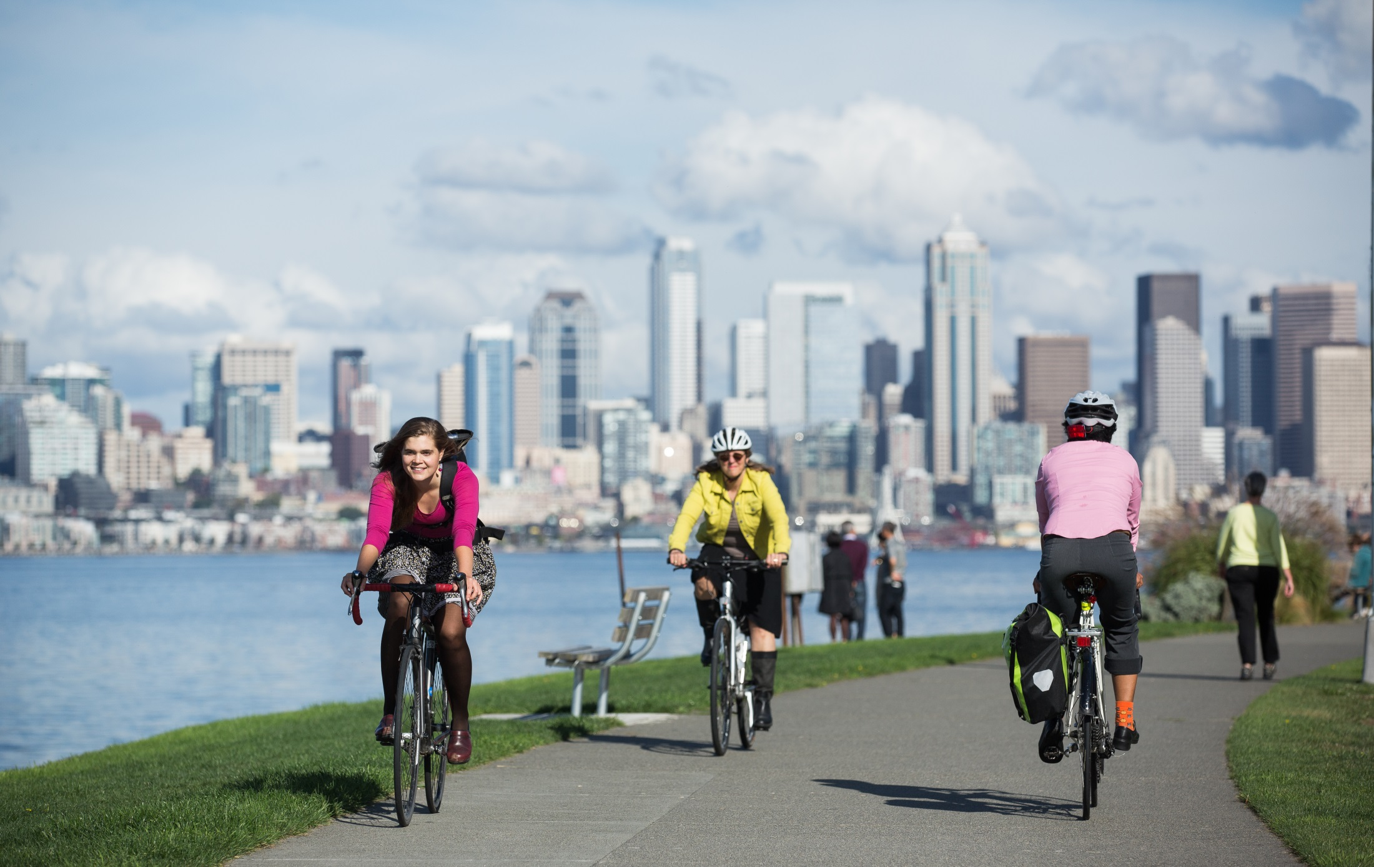

Slide 49
Brock Howell
brockh@cascade.org, 206-856-4788 Policy & Government Affairs Manager, Cascade Bicycle Club

Slide 50
Your Own Advocacy Leadership Institute In a Box

