Slide 1
FASFAA Spring 2015 Workshop
Office of Student Financial Assistance (OSFA)
Region 1

Slide 2
Preview
Legislative Activity
State Programs Updates
OSFA Projects
Training and Resources

Slide 3
Legislative Activity
Session March 3-May 1
Governor’s budget proposes steady funding
Bright Futures summer funding
Includes Honorably Discharged Graduate Assistance Program and Florida Incentive Scholarship
Final conference budget – from the Senate
Notes:
Just because the Governor proposes, does not mean that the House and/or Senate will accept the spending proposals.
The Senate is currently holding budget reviews (estimating conferences) of each agency and both Senate and House will publish their own proposals, usually mid-April.
After much review, a conference committee derives one budget to present to the Governor for review and signature or veto.

Slide 4
Legislative Activity
Proposed Bills
Residency
Fee Waivers
Loan Forgiveness
Cohort Default
Notes:
The loan forgiveness program is a proposal for teachers certified and teaching 8 consecutive years in a STEM area.
The Senate is proposing steps to ensure that Florida postsecondary institutions have lower cohort default rates.
Again, these are only proposals and must follow through the legislative process.
We will send participating institutions memos if there are any changes to state programs.

Slide 5
State Programs Updates
Security overhaul
Require stronger SSFAD password for 2015-16
ACT/SAT enhancements
OSFA is working to modify the file layout of the Test Repository to account for changes made to the ACT/SAT layout
Secure File Transfer Protocol (SFTP) required
See OSFA-STATE #14-15:21, February 2
Notes:
Coming soon…all SSFAD users will be prompted to provide their own password and to include numbers, upper and lowercase letters, and punctuation marks. Be sure to keep your passwords secure and do not share. Email OSFAsecurity@fldoe.org if you have questions about your security level or access.
The file layout will be changing due to ACT/SAT enhancements. Please note, you can find a memo regarding this change online, as well as all other memos sent this year. Go to the SSFAD website and select the Postsecondary Institutions tab. After you login, scroll down to the section titled Publications.

Slide 6
State Programs Updates - Calendar
March 31 – Audits due from private institutions
See Memo OSFA-STATE: #14-15:20, January 8, 2015
June 1 – Reconciliation is due no later than 60 days after the last day of Drop/Add
Notes:
If your 60 days after the last day of drop/add is earlier than Jun 1, we encourage you to reconcile. If you need to make adjustments after the June 1 deadline, please call the program specialist or director for assistance.

Slide 7
State Programs Updates - Application
June 5 – Institution Renewal Application is due.
Opens May 1
Reduced from 76 original questions to 65 questions
Review prefilled data fields for accuracy
Update any changes in information – contacts, licensure, ownership, accreditation
Add your institution’s cost of attendance and term dates for 2015-16
Notes:
Although the look and feel of the Institutional Renewal Application is the same, the workload related to this application has been cut in half! Your favorite part of the application – the statistical questions - are completely gone! We no longer are asking for tuition and fees from the public sector.
Please do take the time to review the prefilled information for accuracy and make corrections.
We encourage you to call Carl Vinson (850-245-1905) if you have any questions about the data on the application or the questions.
A renewal application is required each year for continued participation.

Slide 9
State Programs Updates - Application
Initial Institutional Application
Call beginning May 1 for an application - 850-245-1905
Submit completed application and all requested documents by June 5 for evaluation
Participation notification sent starting July 1
Eligibility requirements posted online under Postsecondary Institutions tab
Statutory Requirements for Participation
Notes:
We do not have the initial institutional application available on the website. We want to avoid having unqualified institutions use up their time filling out an initial application when they may not be eligible. If you are new to Florida or have been here a while and just wish to participate, first call Carl Vinson. He will perform a preliminary assessment of your institution and advise you if you should go forward with the application process.
If you should choose to apply, please ensure that all questions are completely answered. Incomplete applications will delay eligibility or lead to denial of eligibility.
You may review all requirements for all programs on the SSFAD website. Select the Postsecondary Institution tab and then Statutory Requirements for Participation.

Slide 10
State Programs Updates - Calendar
June 30 – FWEP Allocation Request for next fiscal year is due
June 30 – 2014-15 FWEP Annual Financial Summary Report is due
June 30 – Grade and Hours Report for ALL programs is due 30 days after the end of the spring term and no later than June 30th
Notes:
Although you have until June 30 to complete your Grade and Hours reporting, please know that the earlier you turn these into OSFA, the sooner OSFA can determine renewal eligibility for students receiving the Rosewood Family Scholarship, the Jose Mart Scholarship, the Scholarships for Children/Spouses of Deceased or Disabled Veterans, or Bright Futures.
If your 30 days after the end of the spring term is after June 30, your institution is still required to meet this statutory deadline.
OSFA posts all renewal notification on the students’ online Financial Aid Recipient History screen.

Slide 11
OSFA Projects
FAFSA Completion Initiative
To ensure that America’s students take the first step toward college success – filing the FAFSA
Each public school district will certify data integrity and security for ability to access the district’s list of students who have filed the FAFSA
Notes:
Just an FYI to reps providing this presentation: This is not yet complete. OSFA is waiting for the go ahead from the Commissioner and must contact all districts.

Slide 12
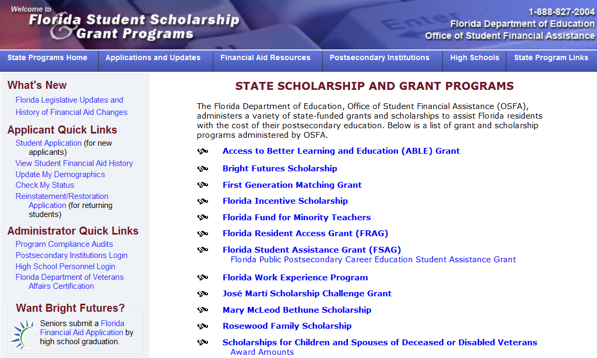
Training & Resources
Your Reporting/Sources
Resources on the website at http://www.floridastudentfinancialaid.org/SSFAD/home/uamain.htm
Student History Screen
FACT Sheets

Slide 13
Training & Resources
State Programs tab
Annual Report to the Commissioner
End of Year Reports
Florida Statutes and State Board of Education Rules
Postsecondary Institution tab
Renewal participation application
All reporting functions
DER
Reconciliation
Grade and Hours Report
Allocation Request Screens
Institutional eligibility and policy
Calendar, Policy Manual, Memorandum

Slide 14
Training & Resources
Webinars designed just for you!
Call Ariel Floyd 850-245-1890
Personal visits at your convenience
Call OSFA’s Outreach Representatives
FASFAA Region 1 Representative is
Reyonna Parrish
850-410-6830
Reyonna.Parrish@fldoe.org

Slide 15
Training & Resources

Slide 16
Contacts
OSFA@fldoe.org
888-827-2004

